Slide 1
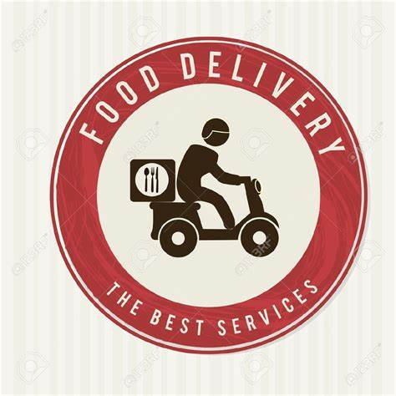
Food Delivery Experience Redesign
User Research & Market Analysis Case Study Author: Sravani Mandaganti

Slide 2

Problem Statement
Key User Pain Points
Inaccurate or incomplete orders ✅
Limited real-time visibility during delivery 👀
Long and inconsistent delivery times ⏱️
Complicated checkout and payment process 🛒

Slide 3
Approach
Research & Analysis Process
User Research: Interviews & surveys to identify friction points
Personas & Journey Mapping: Busy Professional, Bargain Hunter, Social Diner
Market & Competitor Analysis: Benchmarks and feature gaps
Opportunity Framing: High-impact, feasible MVP solutions
Validation Plan: Usability testing + A/B experiments

Slide 4

Personas & Journey Highlights
User Insights & Segmentation
Persona 1 — Busy Professional
Age 24–35 | Software Engineer
Goals: Quick meals, accurate delivery, easy checkout
Pain Points: Long delivery, complicated checkout

Slide 5
Persona 2 — Bargain Hunter
Age 18–30 | Student
Goals: Affordable meals, promo deals
Pain Points: Hidden discounts, confusing promotions
Persona 3 — Social Diner
Age 20–35 | Foodie / Social
Goals: Share meals, group orders
Pain Points: Multiple payment options, delayed split billing

Slide 6

Sample Metrics / KPI Dashboard
Measurable Improvements
Metric | Before | After | Improvement
Avg Time-to-Delivery | 42 mins | 31 mins | 26% faster
Order Accuracy | 87% | 95% | +8%
Checkout Abandonment | 18% | 12% | –6%
Customer Satisfaction | 72% | 86% | +14%

Slide 7
Outcome & Learnings
Key Takeaways
26% reduction in delivery time, 8% higher order accuracy, 14% increase in satisfaction
Streamlined checkout and real-time updates improve trust and engagement
Balancing speed + accuracy provides better long-term experience
User research + data analysis = measurable, validated product improvements

